Slide 1


Machine Learning Research Trends in Africa
ICT in Africa Seminar - Ugali - ML Trends
Members:
John Waithaka, Maurine Gatimu Wanjiku, Kaiza Kunonu Ilomo, Anthony Joseph Jungo

Slide 2
Introduction
ML research in African Countries has grown exponentially over the past 30 year.
The presentation include:
Intro and methods
Results
Limitation and Discussion
The paper informs you on the growth of ML research in the African continent.

Slide 3
Authors’ Background
Absalom El-Shamir Ezugwu
Ph.D. in Computer Science
Computer Science Professor at North West University
Multiple publications on ML, DL, IOT, and AI papers.
Olaide Oyelade
Degree in MSC Computer Science
Research fellow at Queen’s University Belfast.
Multiple publications on ML, ML Optimization and AI papers.

Slide 4
Authors’ Background
Ovre Jeffrey Agushaka
Holds a degree in Computer Science
Teaching and Research Fellow at Federal University of Lafi
Multiple publications on ML, ML Optimization and Computer intelligence papers.
Abiodun M Ikotun
Holds a PHD in Computer Science
Professor at Yaba college of Technology
Multiple publications on ML, ML Optimization and AI papers.

Slide 5
Authors’ Background
Yuh‑Shan Ho
Biomedical informatic Professor at Asia University
He has published papers on Bibliometric analysis in various fields of research
Target Audience: Researchers and Innovators

Slide 6
Methodology
Bibliometric analysis??
Compilation of ML research documentation from the internet.
Use of Science Citation Index EXPANDED to narrow the search.
Use of Excel to analyse the compiled documentation.

Slide 7
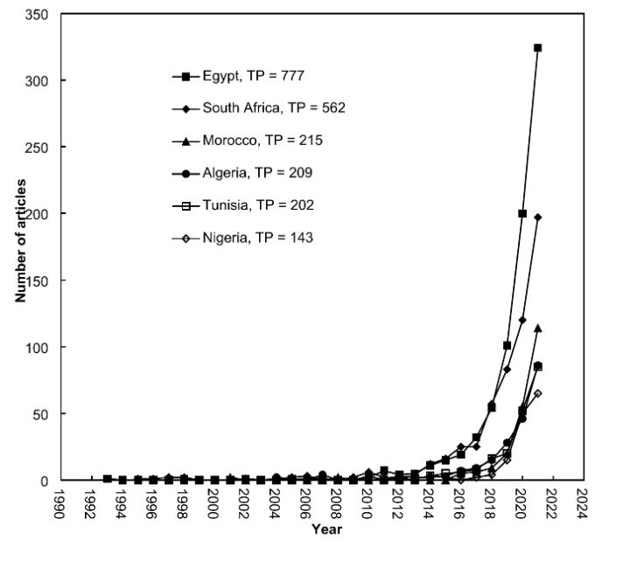
Result: Research trends in Africa
ML research in Africa spiked from 2010 Egypt and South Africa (54%) had the highest number of the ML documentation.
Source: ML Research Trends in Africa.

Slide 8
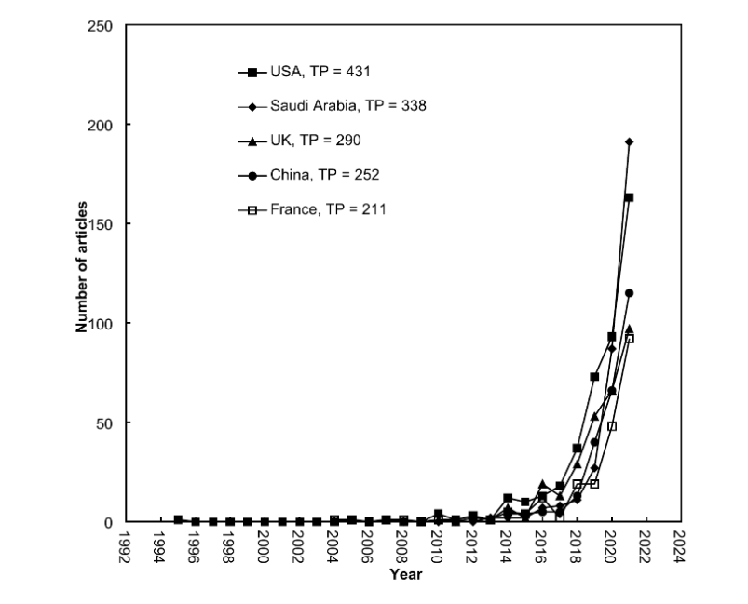
Result: Research trends in Africa
64% international collaborative research
27% intra collaborative research within Africa.
The highest numbers of international collaboration was with The US
Source: ML Research Trends in Africa.

Slide 9
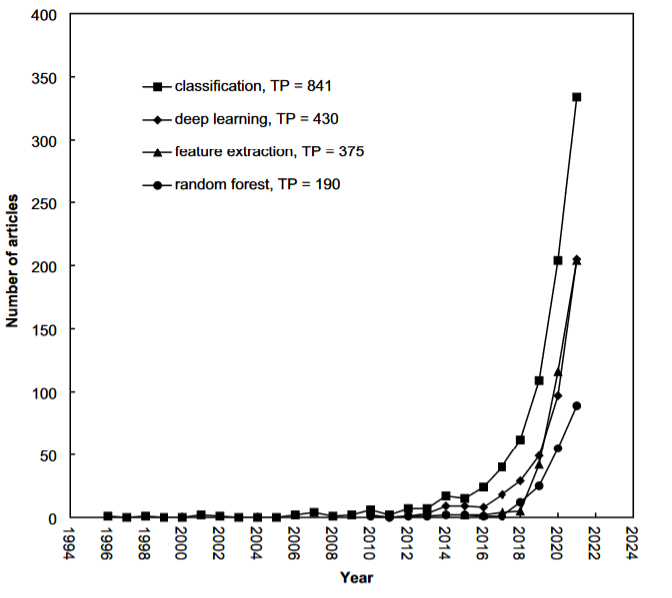
Result: Research trends in Africa
Highest number of the documentation were on classification
Source: ML Research Trends in Africa.

Slide 10
Limitations
Only 3 articles out of 2468 were from Francophone Africa.
This makes their methodology questionable.
Source: ML Research Trends in Africa.

Slide 11
Limitations continued.
The paper used only absolute statistical figures.
Relative figures e.g. articles/population or GDP give more context.

Slide 12
Discussion
74% of published articles were international collaborations.
Internationally collaborative articles had a higher number of citations.
Should we encourage international collaboration?
Or is there too much dependence on non-African institutions?
Source: ML Research Trends in Africa.

Slide 13
Discussion: ML Applications
Infrastructures improvement healthcare
Renewable energy
Pollution Control
Climate prediction
Smart Agriculture
Natural Language Processing
Quantum-Based Machine Learning
Quantum-based algorithms that are used to implement machine learning

Slide 14
Conclusion
Authors did a bibliometric analysis on 2761 ML-related documents obtained from Science Citation Index EXPANDED. 89% of them were articles that had been cited over 482 times.
Exponential increase in ML research in Africa
International collaboration associated with slightly higher impact (citations)
The authors used only the 2761 ML documents 3 of which were French-speaking to make a general conclusion on the growth over time.

Slide 15
References
[1] ‘Machine Learning Research Trends in Africa: A 30 Years Overview with Bibliometric Analysis Review - ICT in Africa Seminar - Perusall’. Accessed: Feb. 13, 2024. [Online]. Available: https://app.perusall.com/courses/ict-in-africa-seminar/machine-learning-research-trends-in-africa-a-30-years-overview-with-bibliometric-analysis-review?assignmentId=8sgizrx3JYQH82K6J&part=1

Slide 16
Ask Any Question???

